Slide 1
Massage & Stress Management Cynthia Bretheim, Health Educator Nov. 2012

Slide 2
How many of you have gotten a professional massage?
What did it do for you? How did you feel afterward?
It helps you be aware of your thoughts, emotions, and sensations.

Slide 3
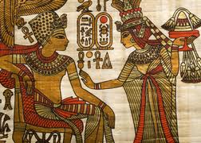
Cave drawings show touch therapies
as early as BC 2330.
Early writings mention different types of massage as
early as BC 722-481.
There are over eighty bodywork modalities today.
Most states require licensing, and there are hundreds of professional schools that train
and certify practitioners in
different modalities.

Slide 4
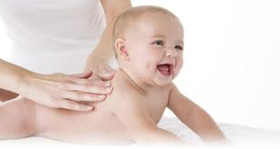
Please expand your touch repertoire
beyond sex, sports, or violence.
This is especially important to those who plan to have children. Know how strong your hands are and be comfortable with healthy touch.

Slide 5
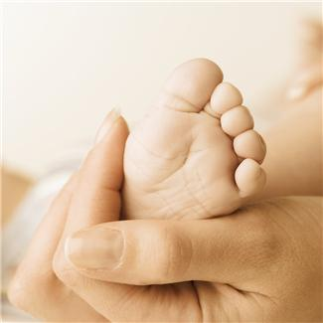
Our bodies need touch in order to thrive.

Slide 6
Stay seated or standing.
Lift one leg. Lift the other leg.
How do they feel?
Rub your hands together briskly, and slide them around the top of your left or right thigh. Squeeze and shake your muscles all the way down to your foot.
Lift one leg. Lift the other leg.
How do they feel?
Hmmm…

Slide 7
Benefits of Massage
Increases circulation
Slows breathing
Equalizes blood pressure
Enhances immunity by stimulating lymph flow
Enhances your mood by releasing feel-good endorphins
Creates chemical changes that reduce pain and stress throughout the body. Cortisol, which is produced when you are stressed, is reduced after massage.
Helps athletes of any level prepare for and recover from strenuous workouts.
Helps decrease pain from fibromyalgia, migraines, and recent surgery.

Slide 8
Massage also:
Reduces withdrawal symptoms in adults trying to quit smoking. Why? (So massage might help you.)
Helped children who were massaged every day by their parents stick to their diet regimens, which helped reduce their blood glucose levels. (So it might help you follow your inner wisdom.) Why?

Slide 9
Lights, camera, action
Your nervous system and senses
Other people, events
Weather, environment
Massage helps you become aware of your environment and the conditions affecting you, so you can use techniques and focus to protect your health.
Lights, camera, action
Your nervous system and senses
Health Other people, events
Techniques
and Habits
Weather, environment
YOU.
Thoughts, Emotions, Sensations, etc.
YOU.
Thoughts, Emotions, Sensations, etc.

Slide 10
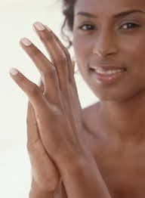
So let’s try some massage right now.
First, shake out your hands.
Hold and squeeze tops of shoulders and neck.
Grip the trapezius and let the arms hang. If it’s more comfortable, cross your arms.
Massage and squeeze the arm from the deltoid all the way to your hand, rolling the tissue
across the bone.
Massage wrist, palm, and fingers, and
pinching the web between fingers.

Slide 11
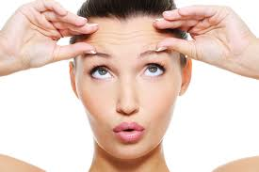
Massage face and scalp. Pull out from the center of the forehead, circle at the temples, and draw small circles around the ear.
Use fingertips to knead the skin on top of the sacrum. Can you pull up your skin and roll it between your fingers?
Grab and squeeze the tissue on either side of the spine as far up as you can.
Now, squeeze and knead the top ridge of the hips.

Slide 12
You can’t reach your back very easily. What other ways are there to massage your back?
Breathe. Move your lower ribcage. Feel the pull on the inside of your spine from muscles of the diaphragm. You could be giving your back a massage with every breath. No pauses or breath holding. See how deeply and slowly you can breathe. http://coherence.com/coherence_clock_html_production1.htm
Stretch from side to side, forward and back.

Slide 13
Consider the benefits of massage.
Does it offer short-term gratification?
Does it offer long-term gratification?
You can do it yourself, or go to a professional. You can trade massages with trusted friends.

Slide 14
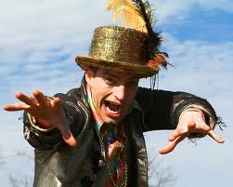
How to choose a massage therapist?
Check them out
Ask your friends for referrals
Trust your gut
Professional massage ethics require proper draping for modesty, and that the massage is done in a safe, confidential, and relaxing environment.
Be sure to say if pressure is too hard or it doesn’t feel right. Massage doesn’t have to hurt to benefit
you. Know the difference between soreness to relieve pain, and just plain hurting.
Trust yourself.
The massage therapist can’t read your mind.

Slide 15
References for more information
Wikipedia.org, http://en.wikipedia.org/wiki/Massage
Ashley Montagu, 1971. Touching, the Human Significance of Skin.
Professional Massage Associations:
Association of Bodywork and Massage Professionals (ABMP)
American Massage Therapy Association (AMTA)
Nat’l. Certification Board for Therapeutic Massage and Bodywork (NCBTMB)
Other modalities: rolfing, Trager, myofacial release, cranio-sacral, Feldenkrais manual therapy

